Slide 1

CAPSTONE PROJECT
ON
MOBILE PRICE RANGE PREDICTION
PRESENTED BY
PRATYUSH KUMAR RATH
BIKESH KUMAR MAHARANA
GAURAV SINGH

Slide 2

CONTENT
❏ Business Understanding
❏ Data Summary
❏ Feature Analysis
❏ Exploratory Data Analysis
❏ Data Pre-processing
❏ Implementing Algorithms
❏ Conclusions

Slide 3

BUSINESS PROBLEMS
In The Competitive Mobile Phone Market Companies Want To Understand Sales Data Of Mobile Phones And Factors Which Drive The Prices. The Objective Is To Find Out Some Relation Between Features Of A Mobile Phone(eg:- Ram, Internal Memory, Etc) And Its Selling Price. In This Problem, We Do Not Have To Predict The Actual Price But A Price Range Indicating How High The Price Is.
So Here We Are Going To Practise Implementing The Machine Learning Models In Order To Predict The Price Range Of Mobiles By Using The Data Set Given.

Slide 4
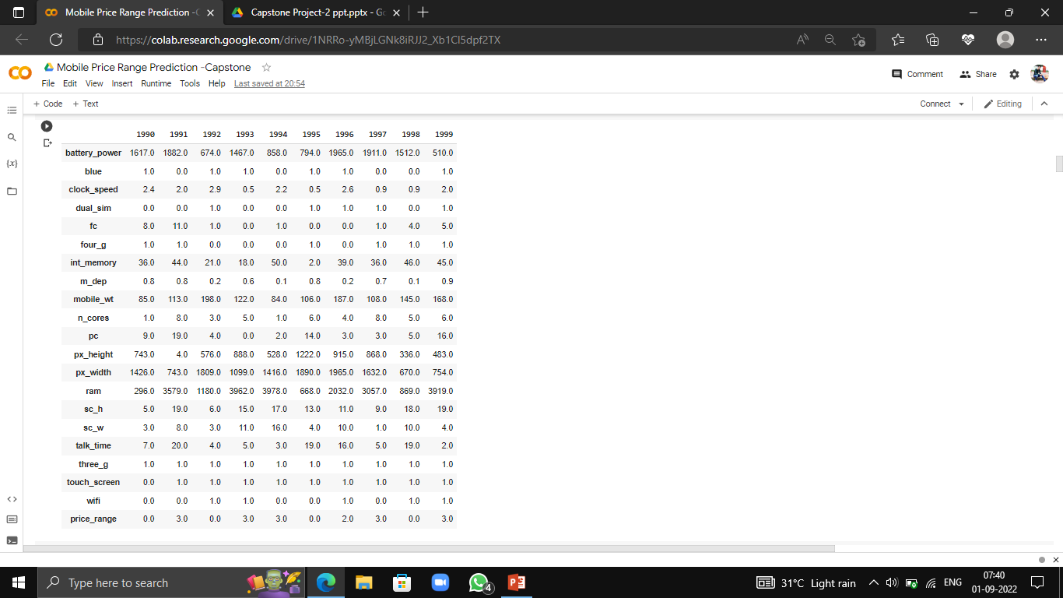
DATA SUMMARY
❏ Here We Have A Total Of 2000 Rows And 21 Columns.
❏ All Features Are Numerical Features, Among Which Features Like Battery Power, Mobile Weight, Pixel Height, Pixel Width, Ram Are Continuous Variables Others Are Discrete.
❏ Among The Discrete Variables There Are Categorical Variable Like 'Bluetooth', 'Dual Sim', '4g', '3g‘ ,'Wifi‘, 'Touch Screen'

Slide 5
FEATURE SUMMARY
Battery_power - Total Energy A Battery Can Store In One Time Measured In ‘mAh’.
Blue - Has Bluetooth Or Not
Clock_speed - Speed At Which Microprocessor Executes Instructions
Dual_sim - Has Dual Sim Support Or Not
Fc - Front Camera Mega Pixels
Four_g - Has 4g Or Not
Int_memory - Internal Memory In Gigabytes
M_dep - Mobile Depth In Cm
Mobile_wt - Weight Of Mobile Phone
N_cores - Number Of Cores Of Processor
Pc - Primary Camera Mega Pixels
Px_height - Pixel Resolution Height
Px_width - Pixel Resolution Width
Ram - Random Access Memory In Mega
Touch_screen - Has Touch Screen Or Not
Wifi - Has Wifi Or Not
Sc_h - Screen Height Of Mobile In Cm
Sc_w - Screen Width Of Mobile In Cm
Talk_time - Longest Time That A Single Battery Charge Will Last When You Are On Call.
Three_g - Has 3g Or Not
Price_range - This Is Target Variable With Value Of 0(low), 1(medium), 2(high) And 3(very High).

Slide 6
DATA INSIGHTS
There Is No Missing Values, No Null Values, No Duplicate Values.
We Have Dependent Variable ‘Price Range’ Which We Will Need To Predict For Future Observations.
It Is Basically A Classification Problem Having Classes 0, 1, 2, 3, Which Predict The Ranges Of The Mobile Price.
First We Have To Convert Every Feature Name According To Its Corresponding Name Which Will Help Us For Better Understanding Of The Dataset.
Here Are Our New Feature Names : 'Battery power', 'Bluetooth', 'CPU Speed', 'Dual Sim', 'Front Camera', '4G', 'ROM', 'Height', 'weight', 'cores', 'Back Camera', 'Pixel Height', 'Pixel width', 'RAM', 'Screen length', 'Screen width', 'Talk time','3G','Touch Screen', 'WiFi', 'Price Range']
Now Let’s Get Into Our Data And Do Exploratory Data Analysis, Feature Engineering, Feature Selection And At The End Implement Machine Learning Models With Respect To The Classification Problem And Predict Some Observations.

Slide 7

EXPLOROTARY DATA ANALYSIS

Slide 8
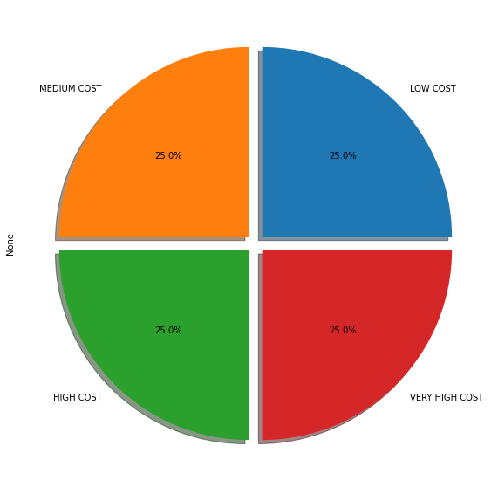
DEPENDENT FEATURE
Our Data Set Have Same Number Of Independent Variables
Our Dataset Has 2000 Total Observations Among Which 500 Numbers Of Each Class Is Present.

Slide 9
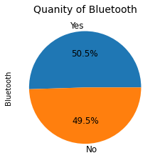
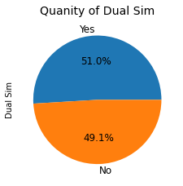
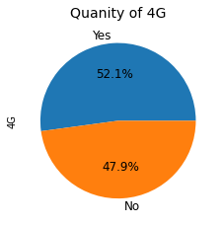
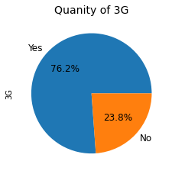

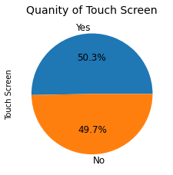
BINARY CLASSES

Slide 10
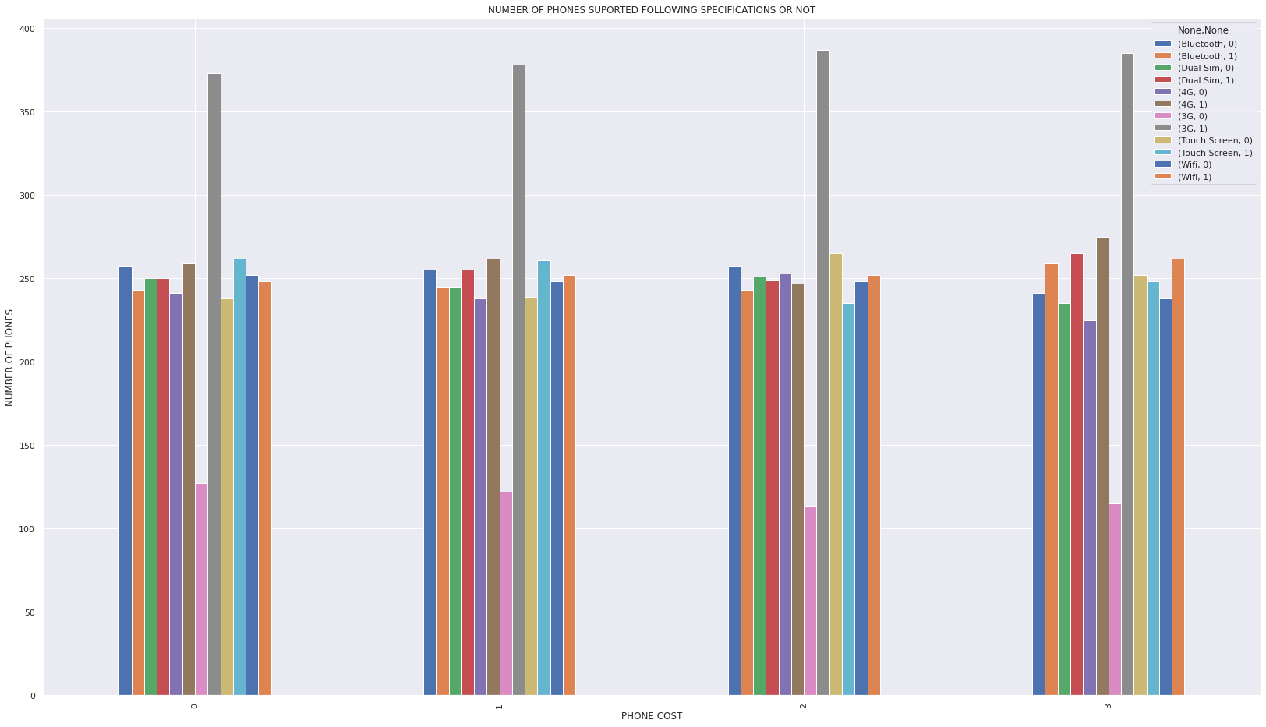
ANALYSIS (BINARY CLASS)

Slide 11
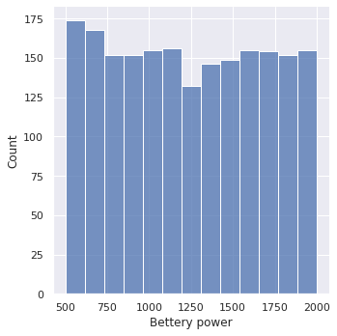
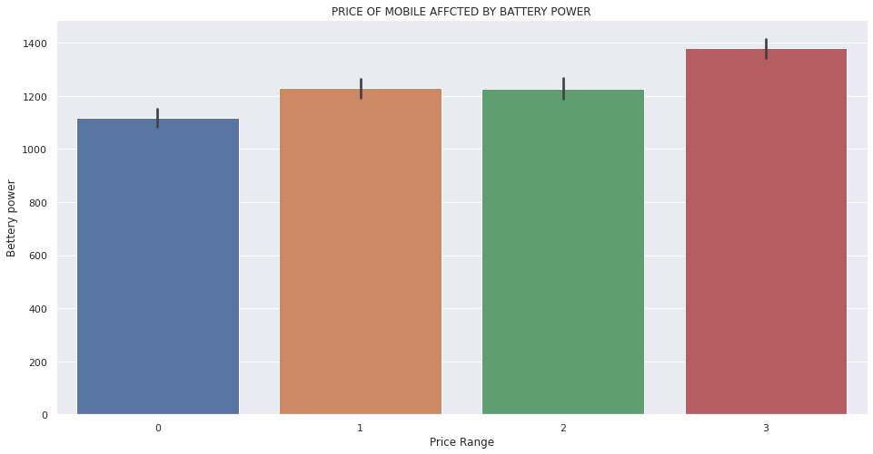
ANALYSIS (BATTERY)

Slide 12
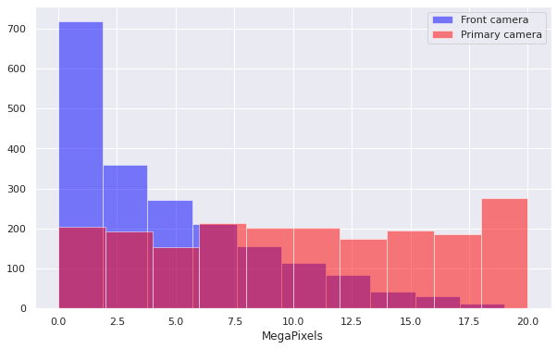
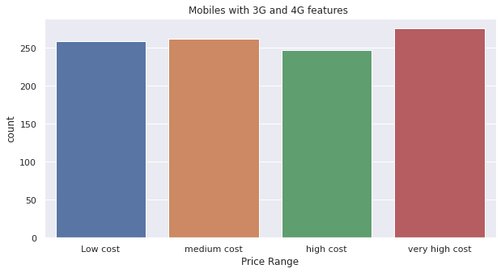
ANALYSIS (CAMERA & 3G 4G)

Slide 13
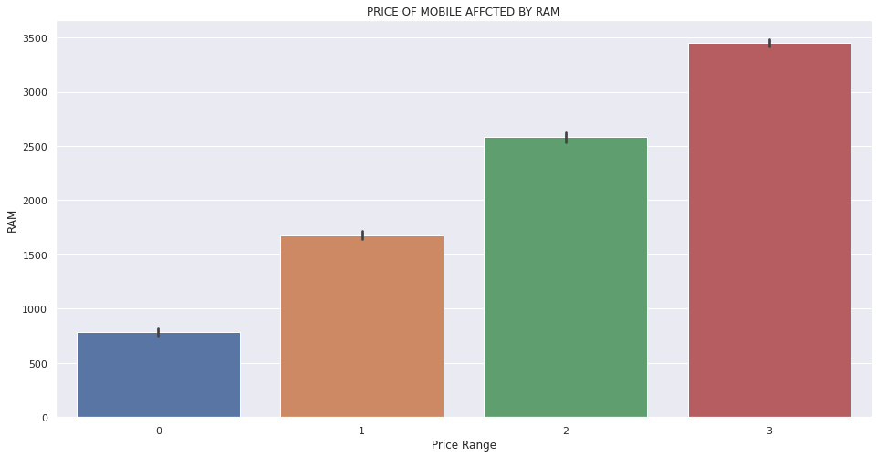
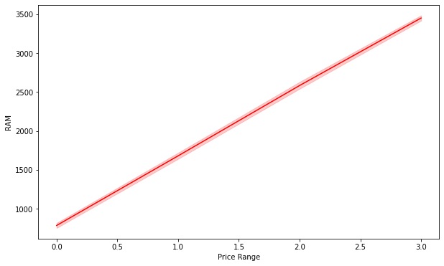
ANALYSIS (RAM)

Slide 14
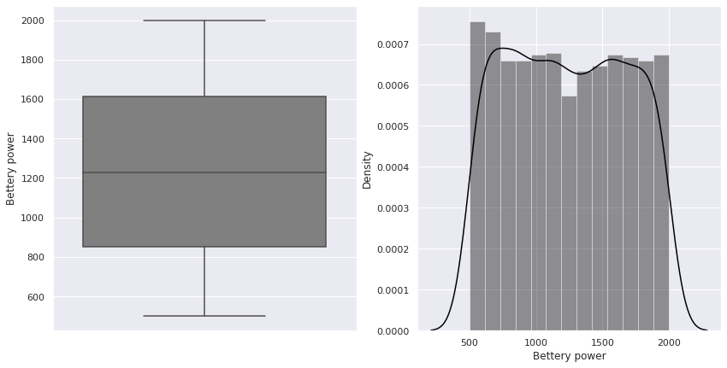
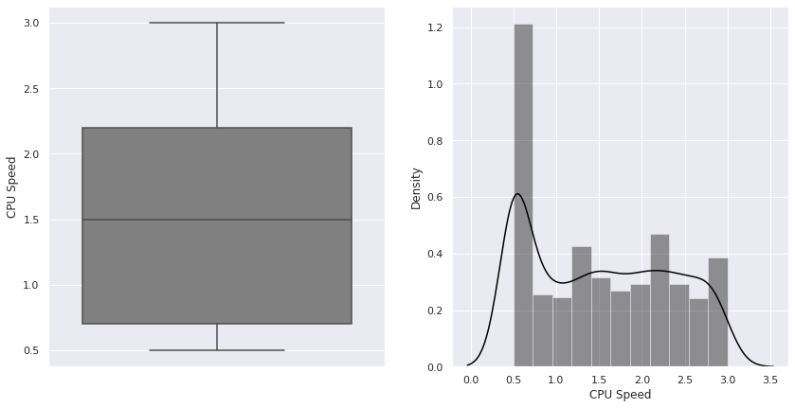
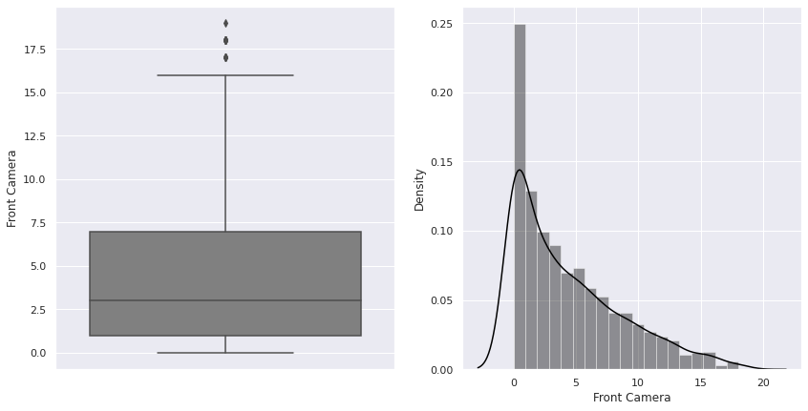
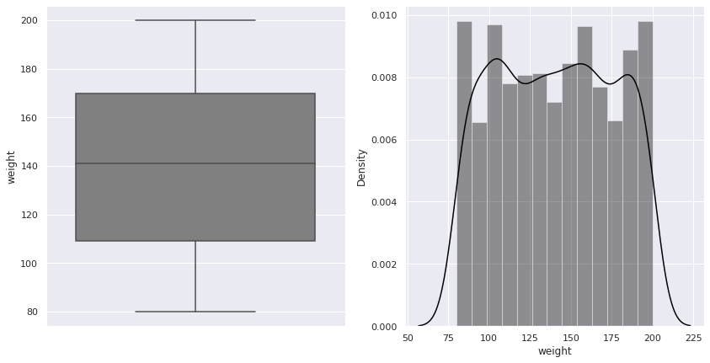
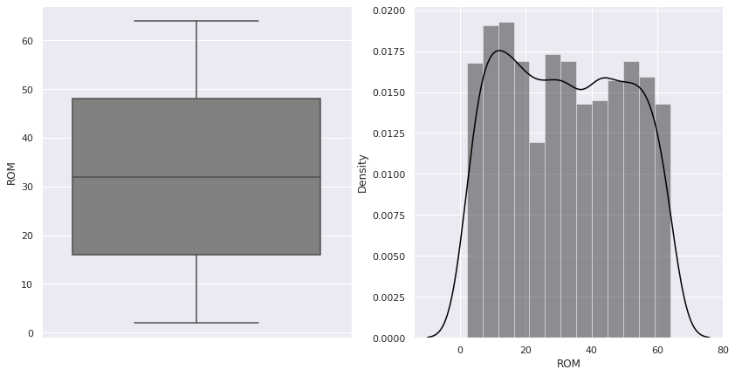
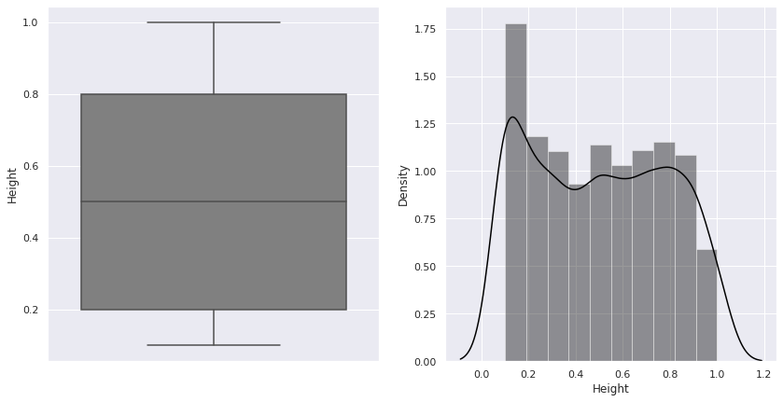
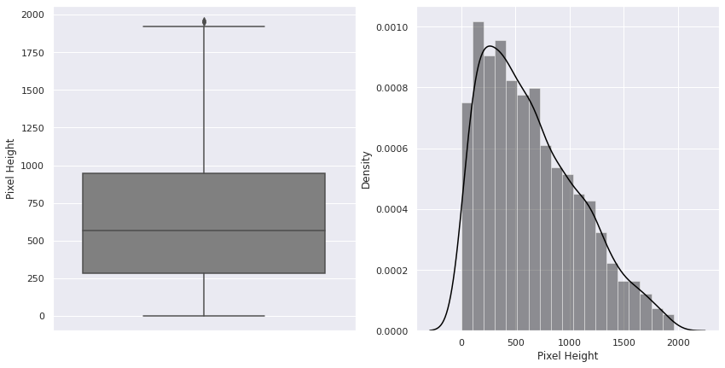
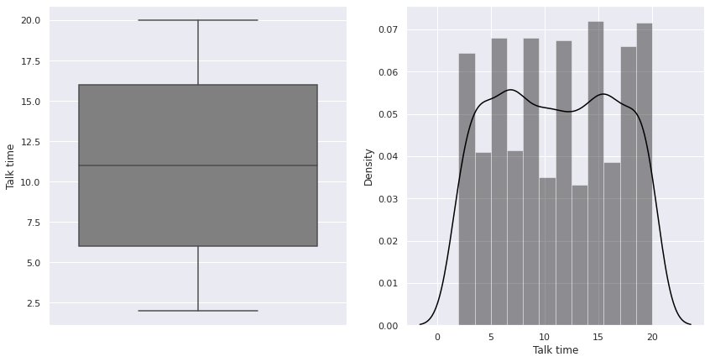
ANALYSIS (CONT.)

Slide 15
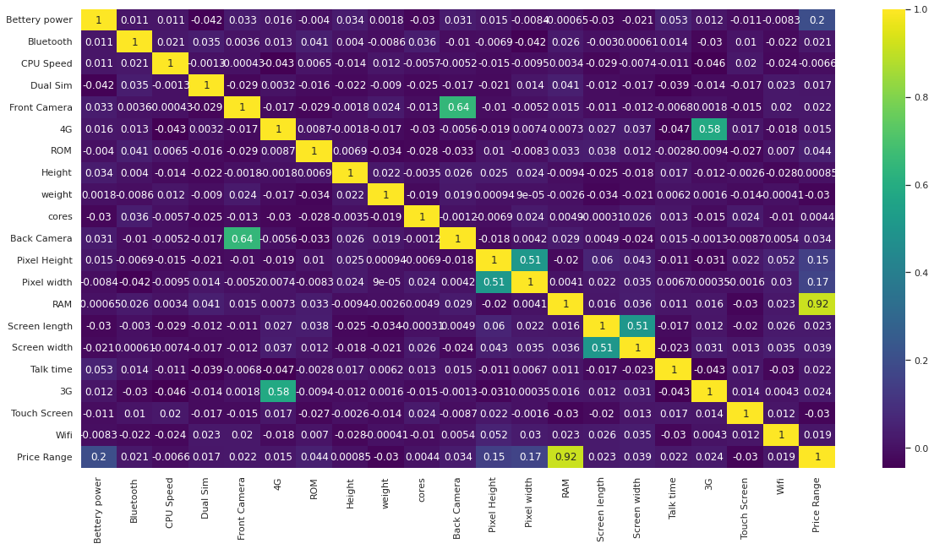
CORRELATION

Slide 16
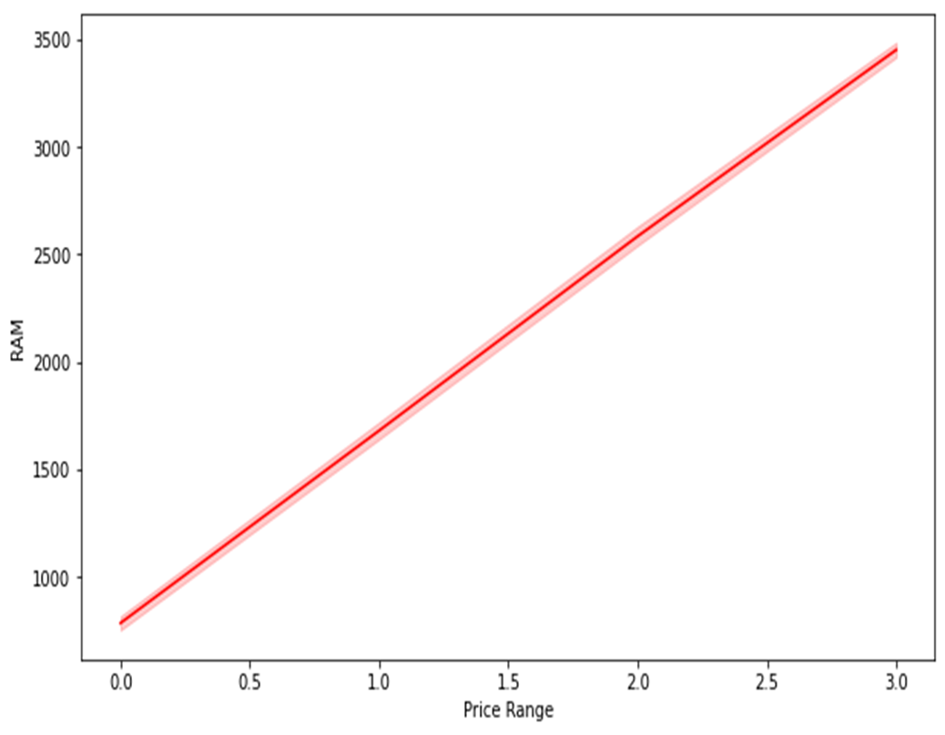
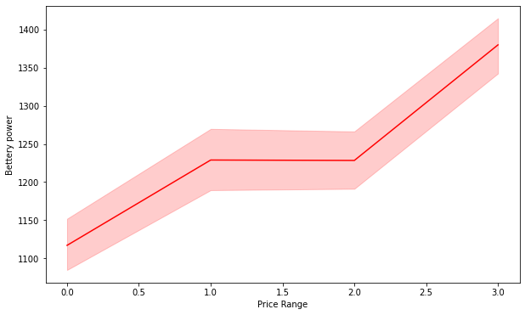
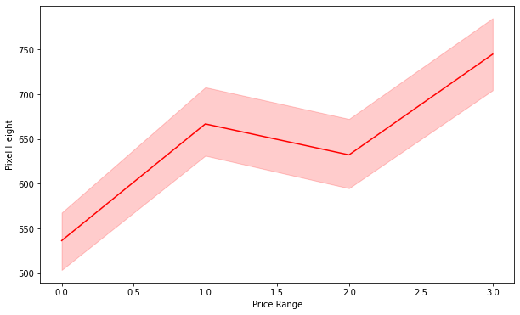
FEATURES HAVING +VE RELATION

Slide 17
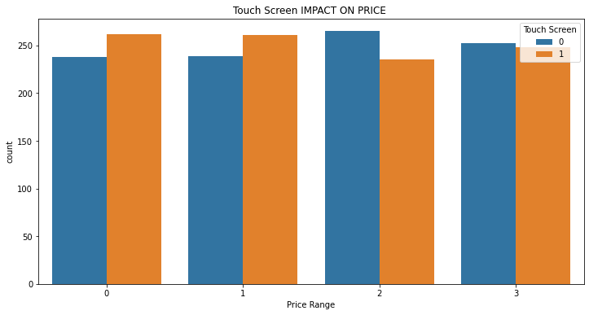
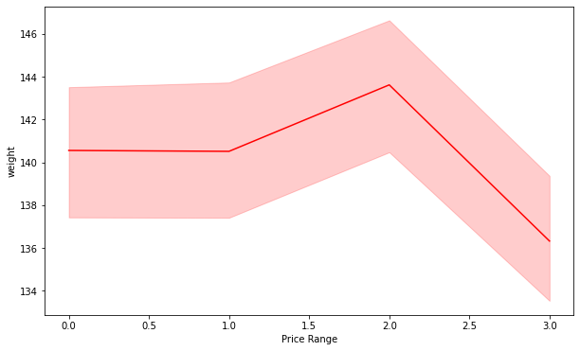
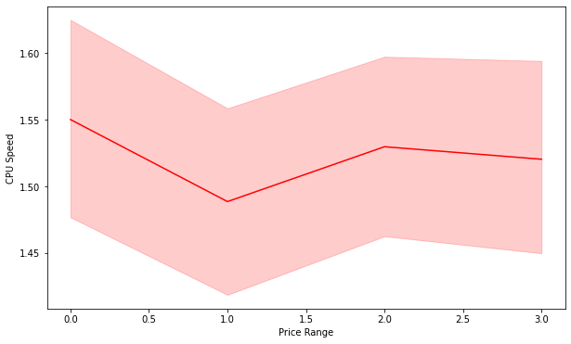
FEATURES HAVING -VE RELATION

Slide 18
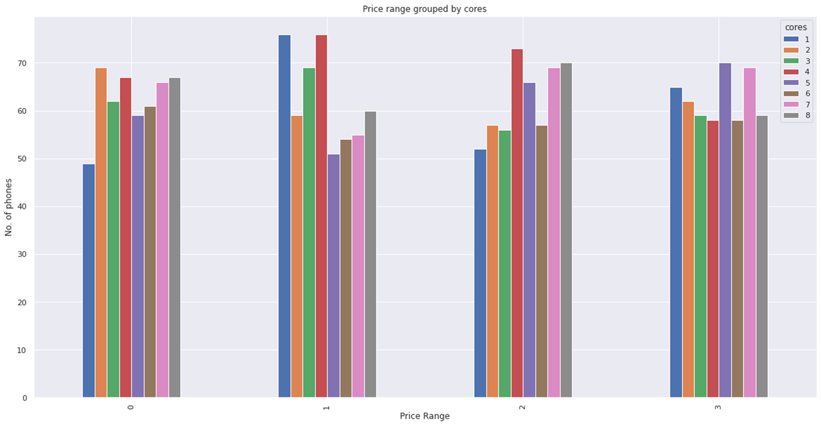
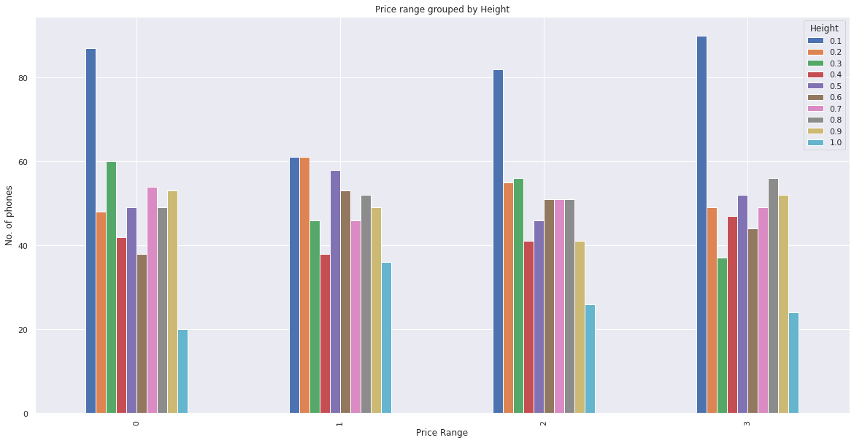
FEATURES HAVING LOW RELATION

Slide 19
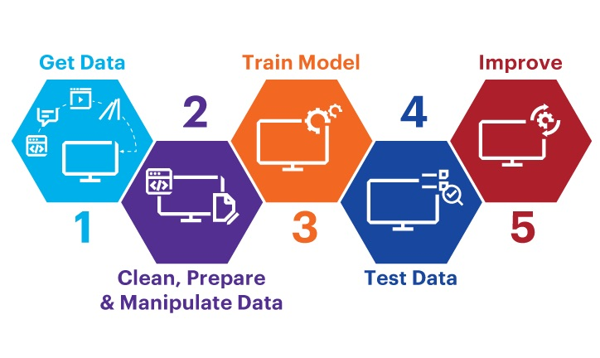
MODEL IMPLEMENTATION
MODEL

Slide 20
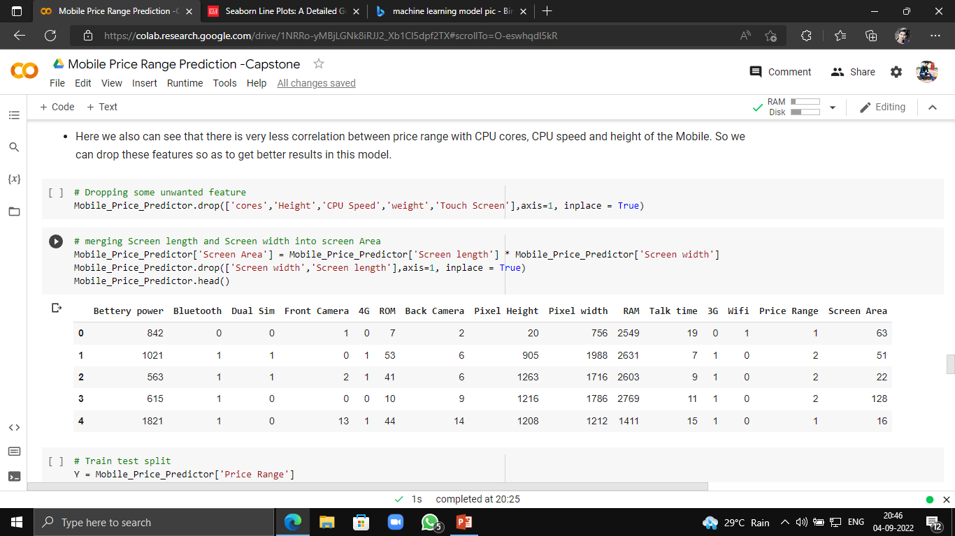
FEATURE ENGINEERING
For The Data Processing For Model Implementation We Have Remove Some Feature Having Very Low Relation With Price Range .
Features Removed – ‘Cores’ , ‘CPU Speed’ , ‘Touch Screen’ , ‘Height’ , ‘Weight’.
For The Better Implementation We Have Created A New Feature ‘Screen Area’ Merging The Features Like ‘Screen Length’ And ‘Screen Width’.
The Data Set Is Split Into Train And Test Data Set With Standardisation In The Ratio 8:2 And Fit Our Models.

Slide 21

MODELS
LOGISTIC REGRESSION
DESCISION TREE
RANDOM FOREST
NAIVE BAYES
KNN CLASSIFIER
SUPPORT VECTOR MACHINE
GRADIENT BOOSTING

Slide 22
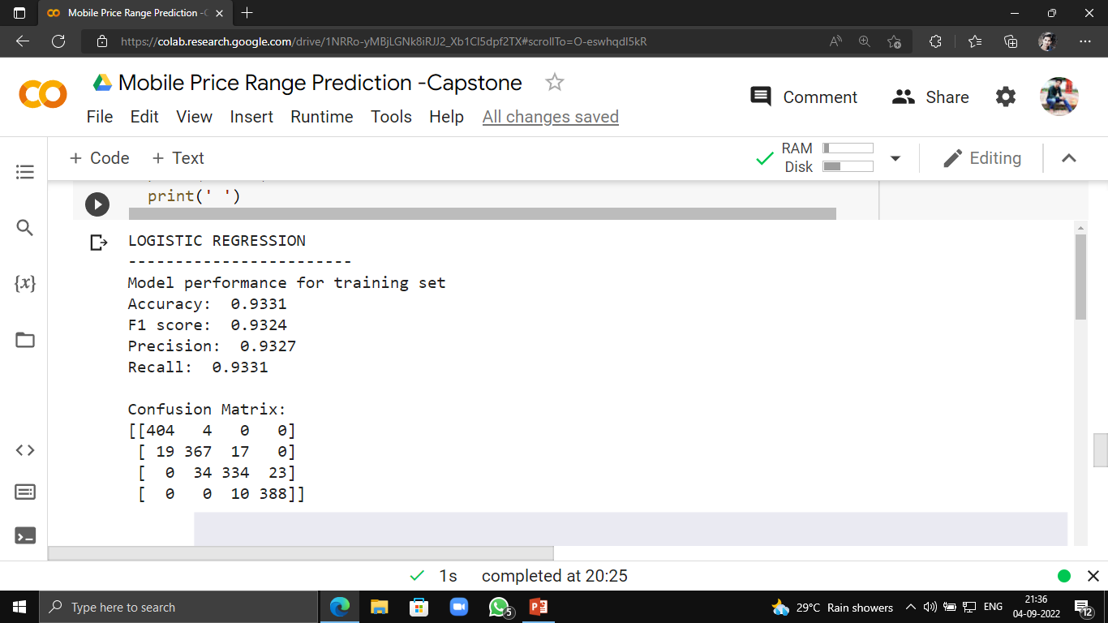
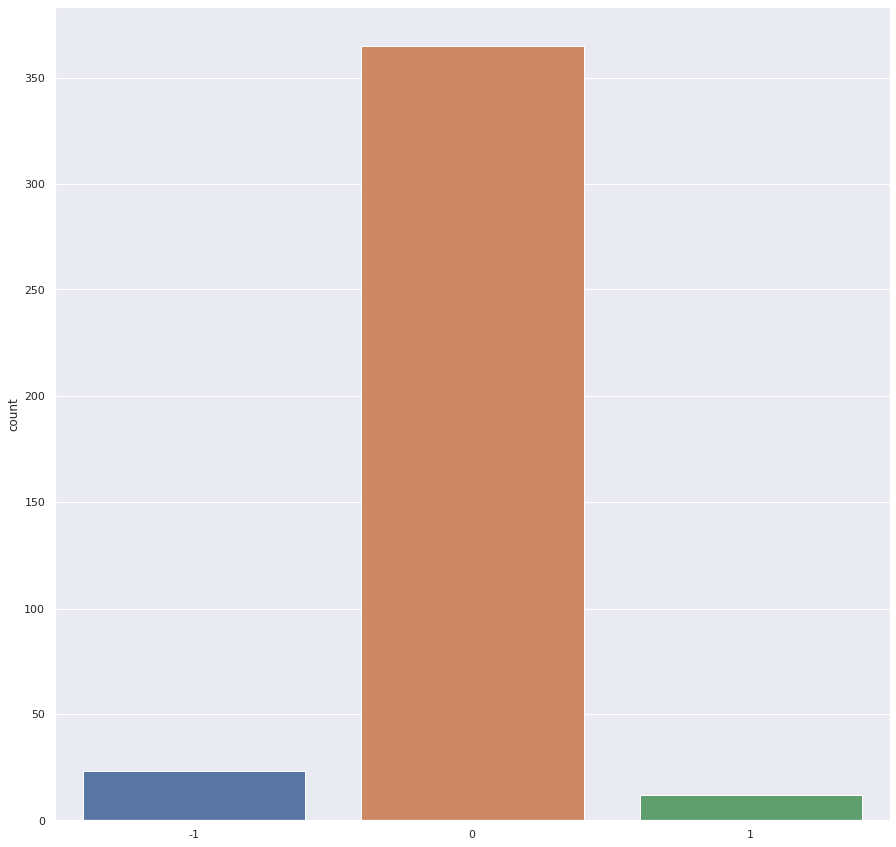
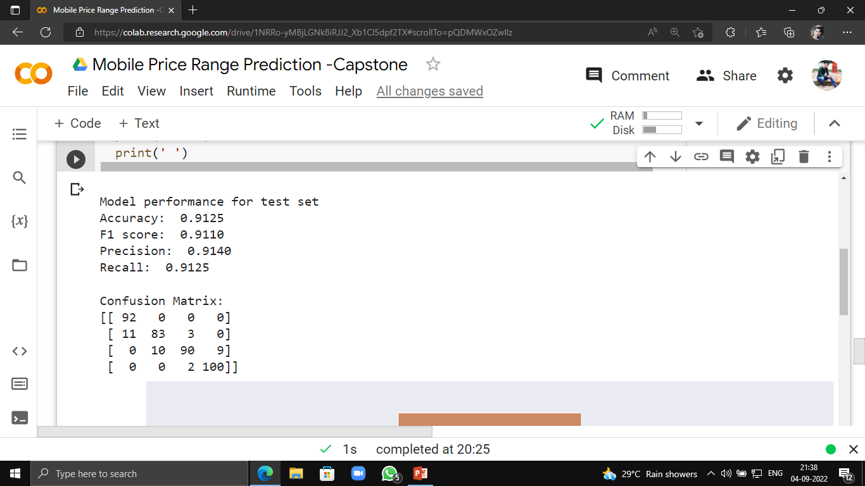
LOGISTIC REGRESSION

Slide 23
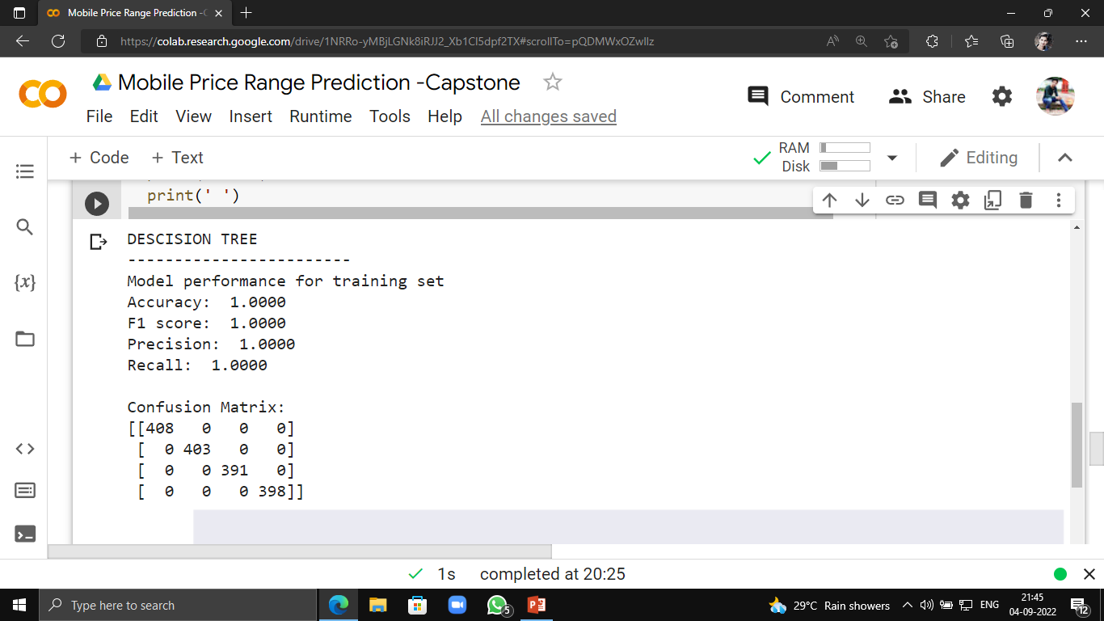
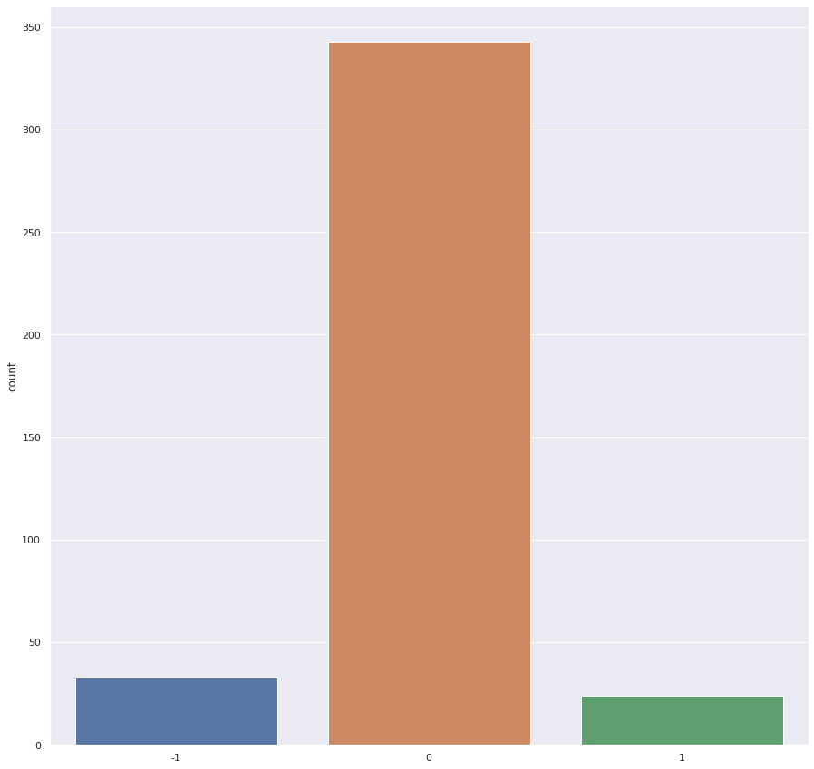
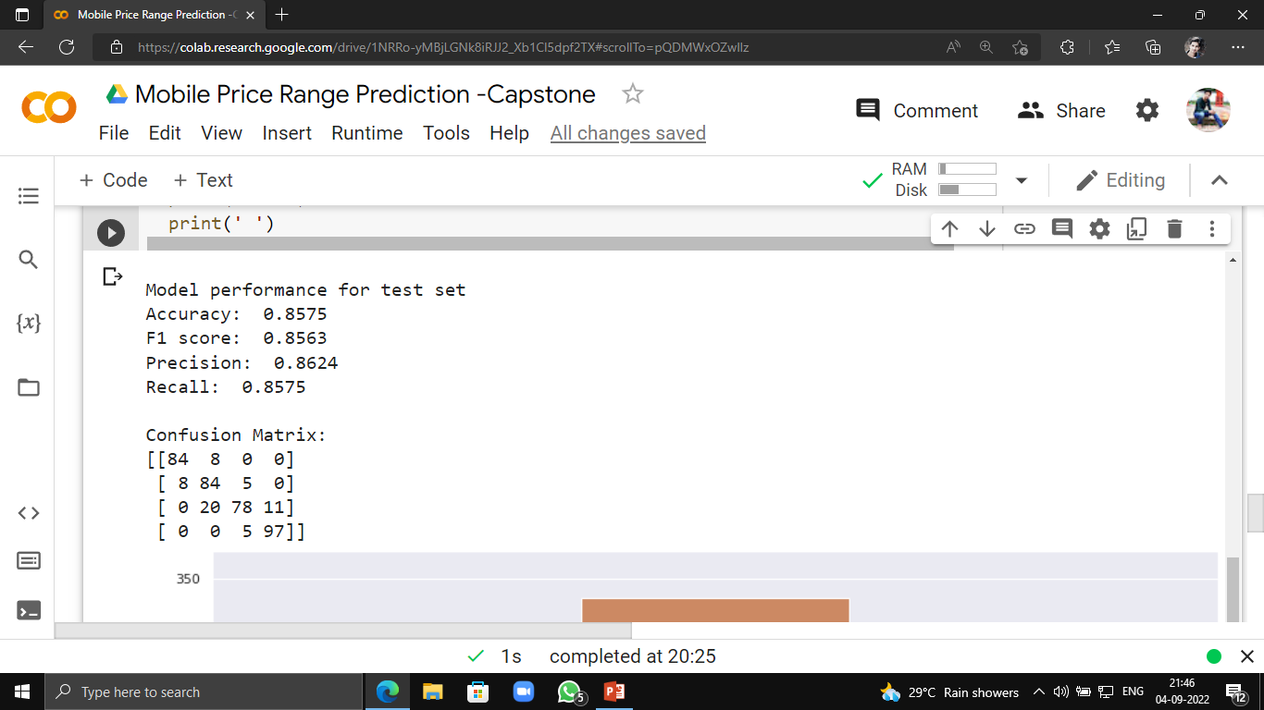
DESCISION TREE

Slide 24
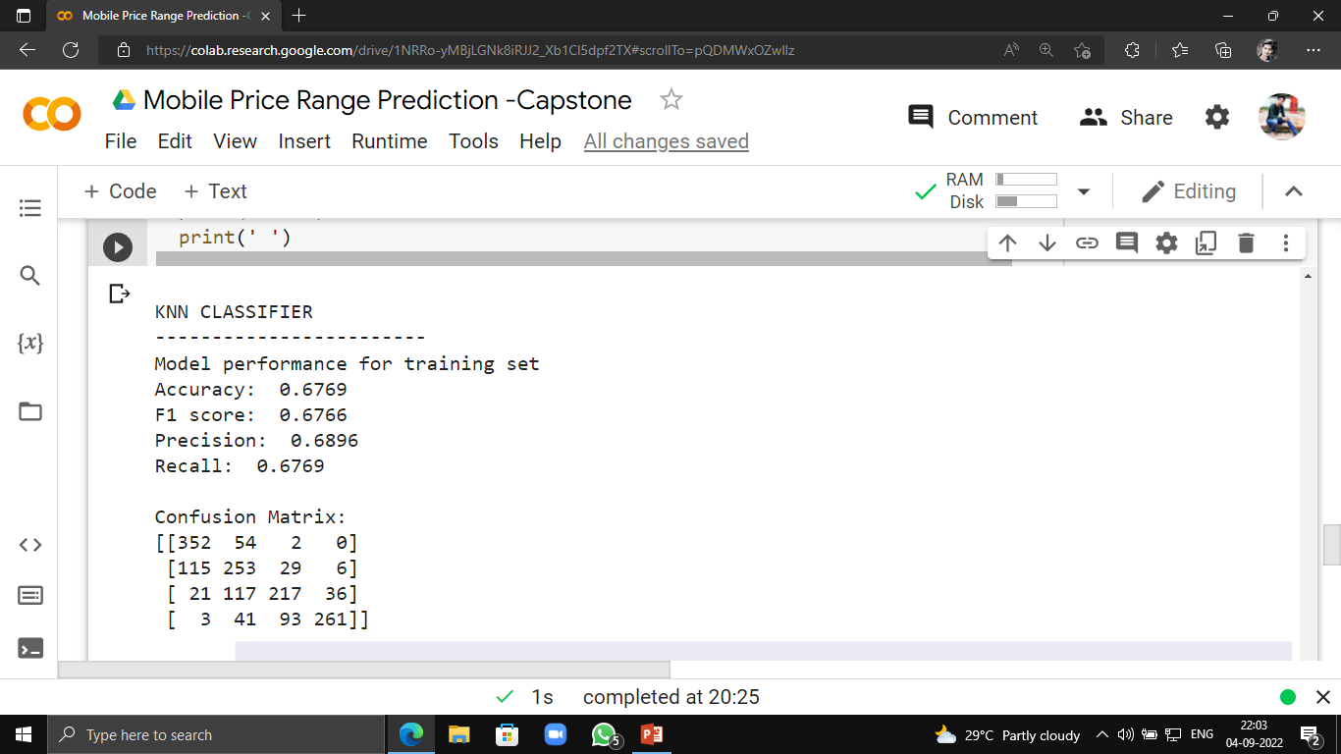
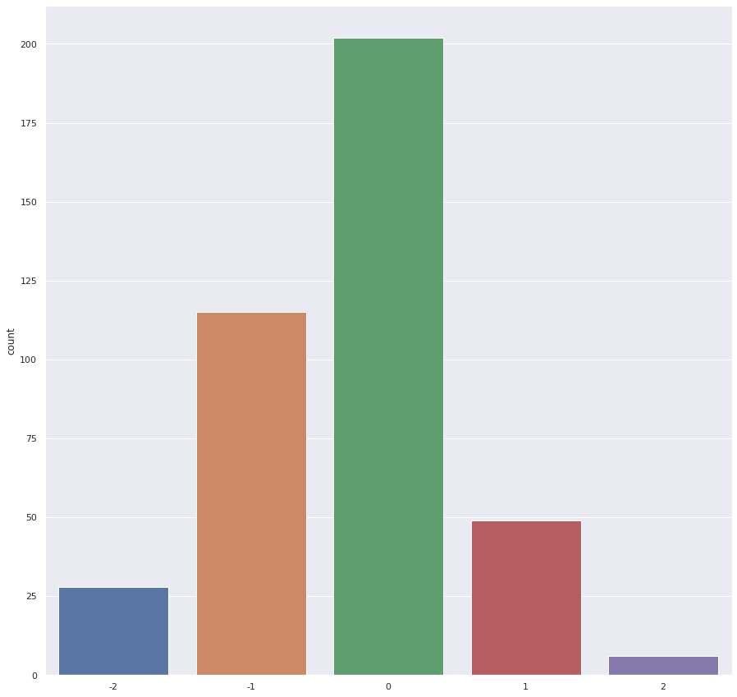
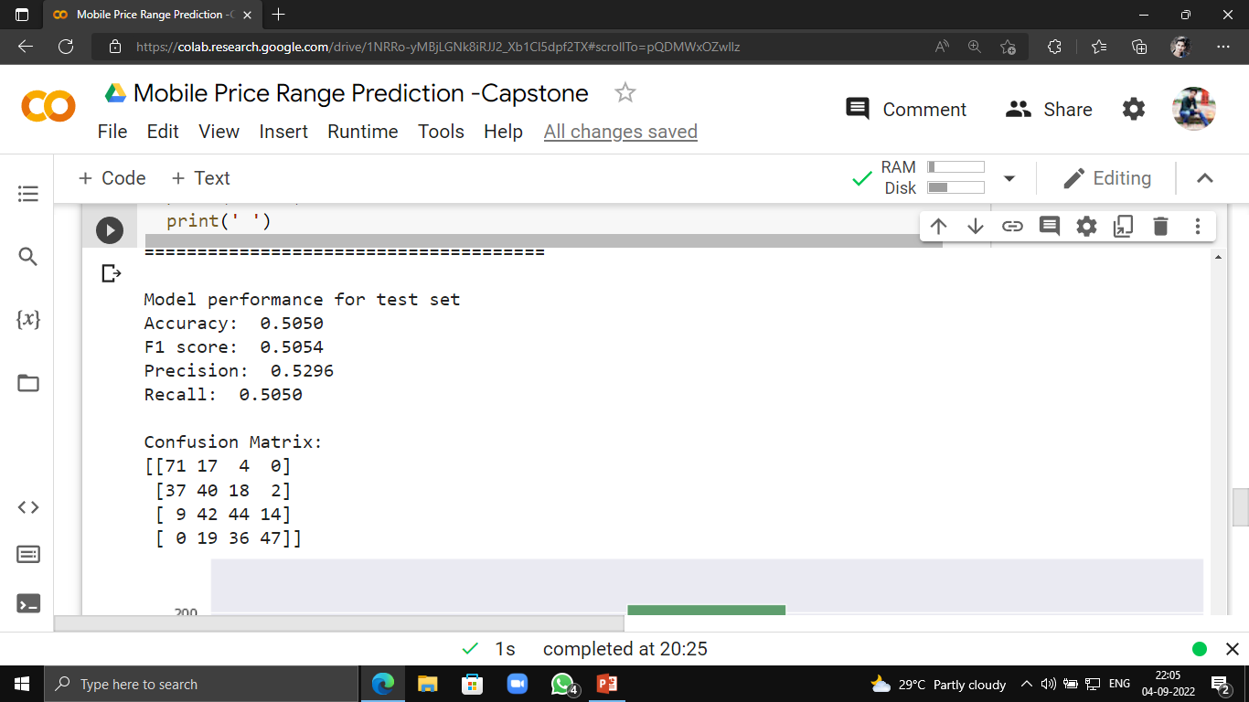
KNN CLASSIFIER

Slide 25
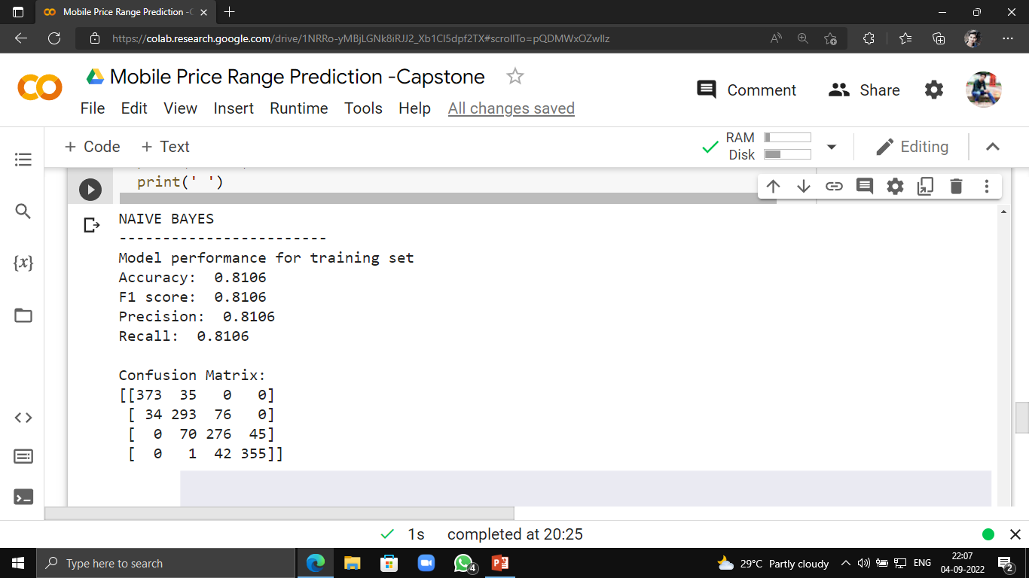
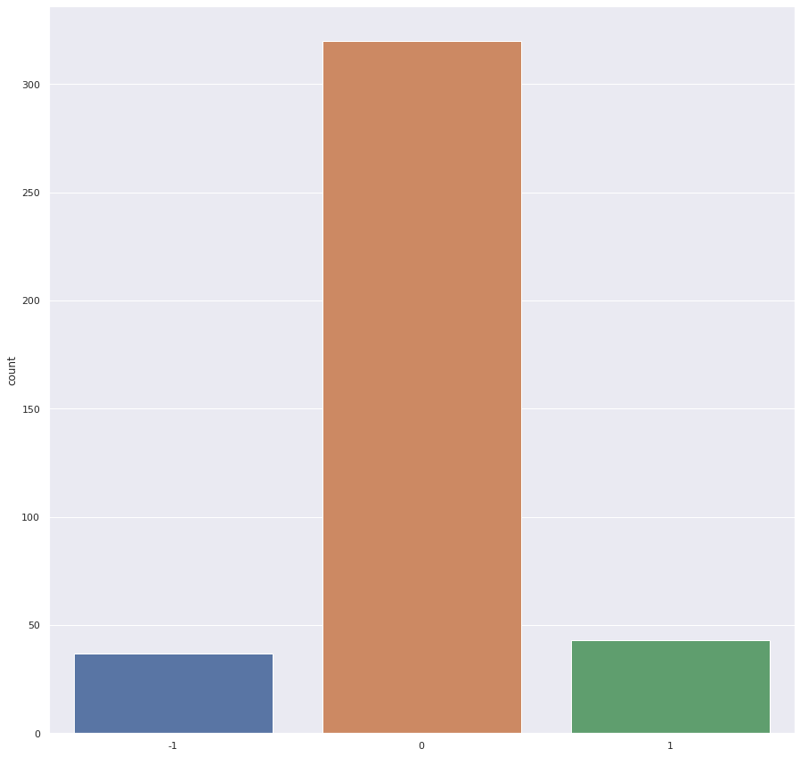
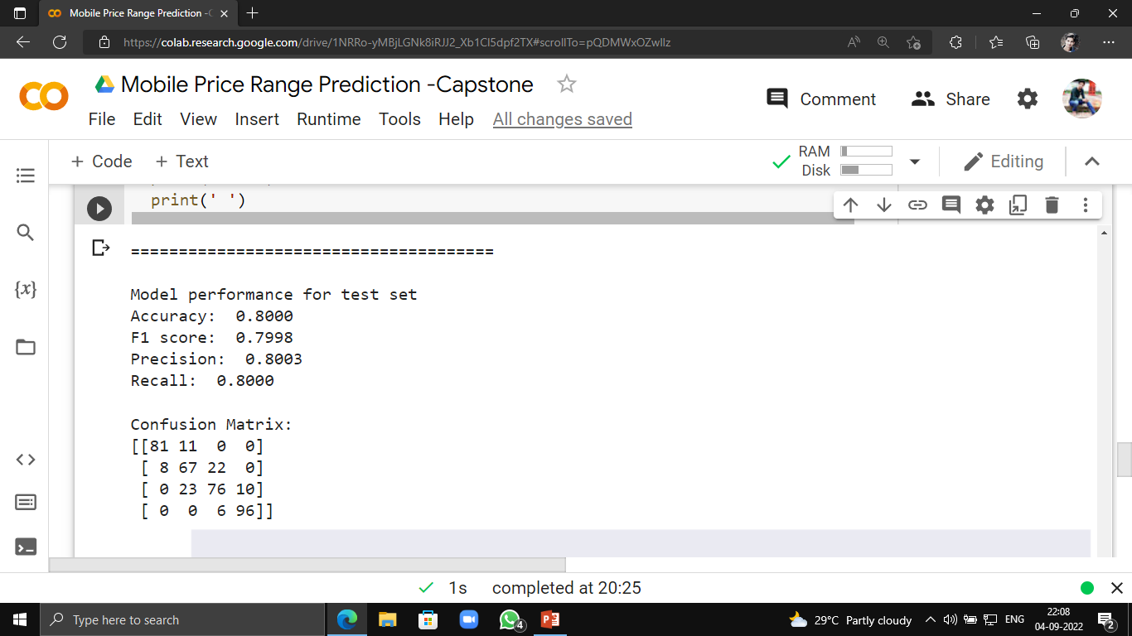
NAÏVE BAYES

Slide 26

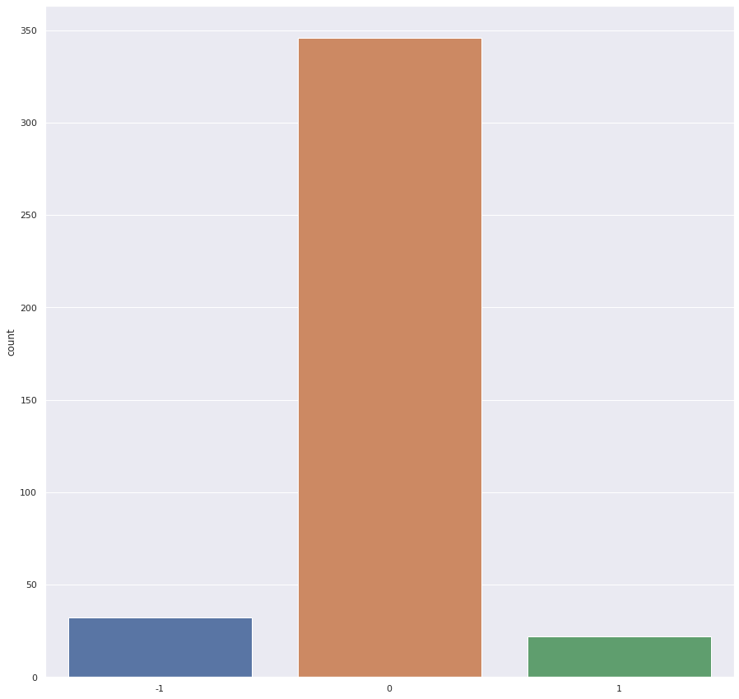
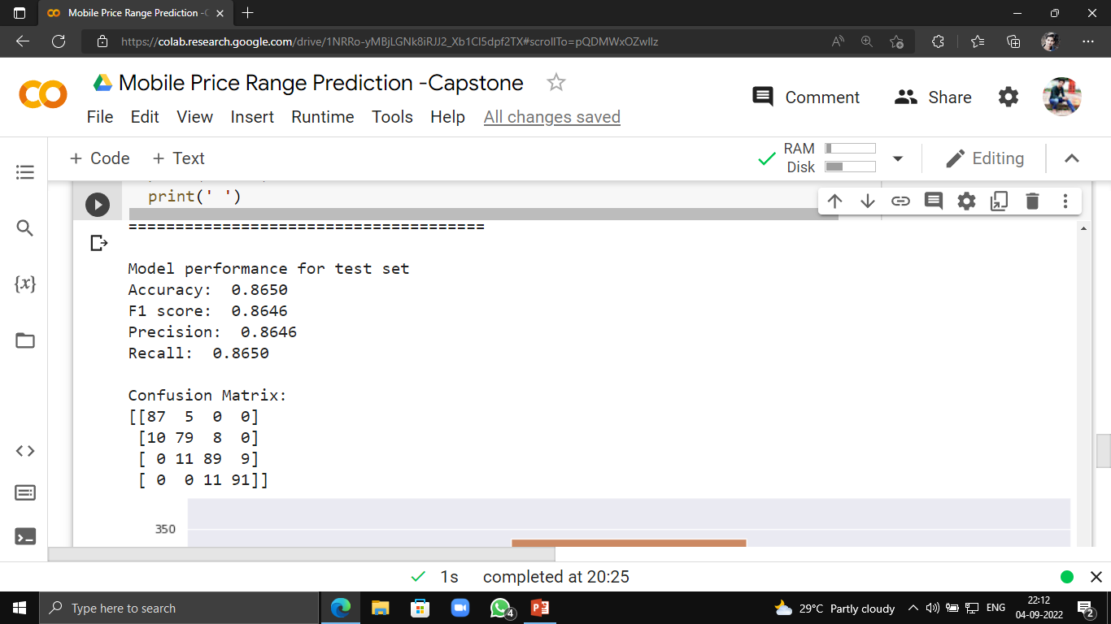
SUPORT VECTOR MACHINE

Slide 27
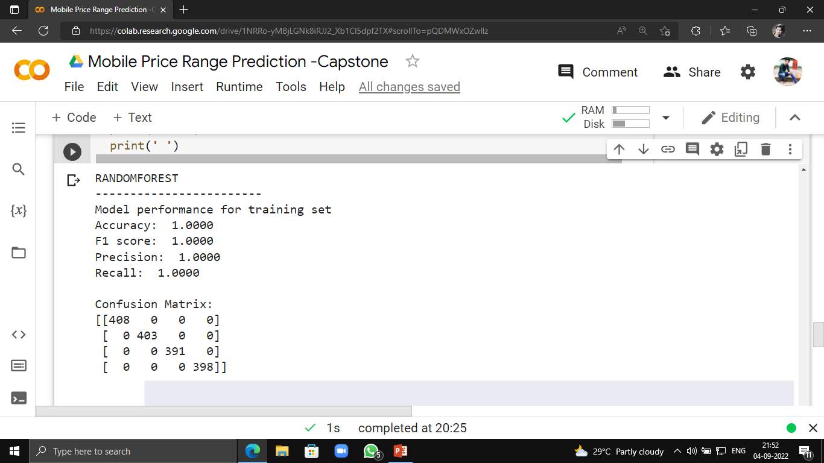
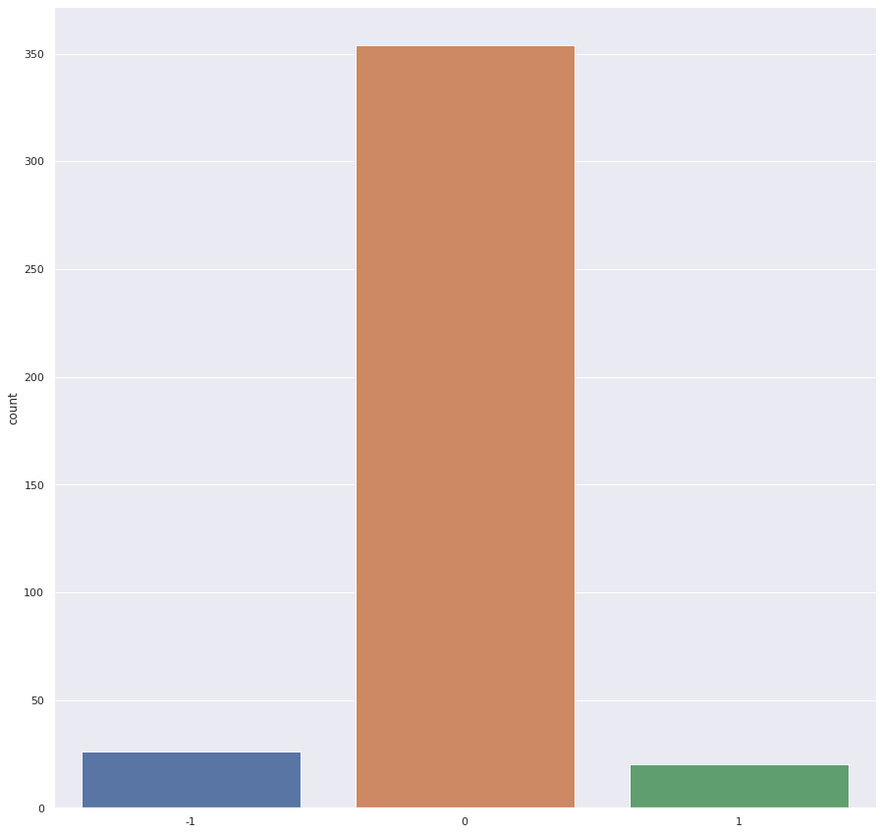
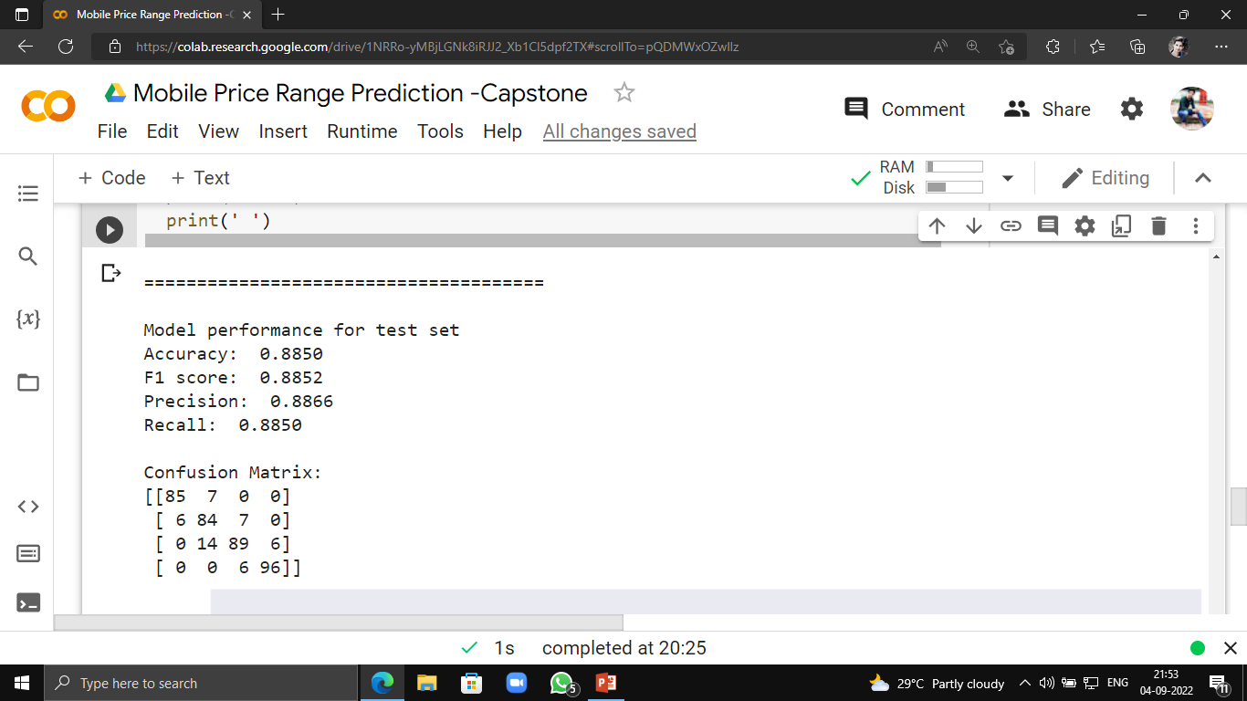
RANDOM FOREST

Slide 28


HYPER PARAMETER TUNING (RANDOM FOREST)

Slide 29



GRADIENT BOOSTING

Slide 30


HYPER PARAMETER TUNING (GRADIENT BOOSTING)

Slide 31
CONCLUSION
From The EDA We Get That The Feature ‘RAM’ Is The Most Relative Feature With Our Dependable Feature ‘Price Range’. More RAM Capacity Will Increase The Price Of The Mobile.
The Battery Power And Pixel Height Also Positively Correlated With Price Range That Means It Will Also Create Some Impact To The Calculation.
By Implementing All The Models We Have Found That Gradient Boosting Has The Best Score Of 91.2% Followed By Logistic Regression of 91.1% And Random Forest Of 89%.
By Appling Hyper Parameter Tuning We Get The Score Of Gradient Boosting Of 92%.
So We Can Conclude That The Best For This Dataset Is Gradient Boosting With Hyper Parameter Tuning, Which Can Be Used For Future Prediction Of The DataSet.

Slide 32

THANK YOU

